Slide 1
Assembly Language for Intel-Based Computers, 6th Edition
Kip Irvine
Chapter 2: IA-32 Processor Architecture
Slides prepared by the author
Revision date: June 4, 2006
(c) Pearson Education, 2006-2007. All rights reserved. You may modify and copy this slide show for your personal use, or for use in the classroom, as long as this copyright statement, the author's name, and the title are not changed.

Slide 2
Chapter Overview
General Concepts
IA-32 Processor Architecture
IA-32 Memory Management
Components of an IA-32 Microcomputer
Input-Output System
Irvine, Kip R. Assembly Language for Intel-Based Computers 5/e, 2007.

Slide 3
General Concepts
Basic microcomputer design
Instruction execution cycle
Reading from memory
How programs run
Irvine, Kip R. Assembly Language for Intel-Based Computers 5/e, 2007.

Slide 4
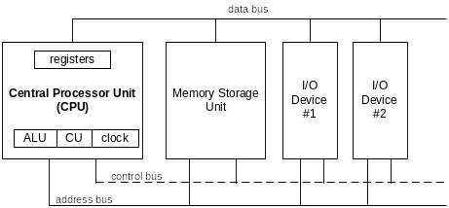
Basic Microcomputer Design
Clock synchronizes CPU operations
Control Unit (CU) coordinates sequence of execution steps
Arithmetic Logic Unit (ALU) performs arithmetic and bitwise processing
Irvine, Kip R. Assembly Language for Intel-Based Computers 5/e, 2007.

Slide 5
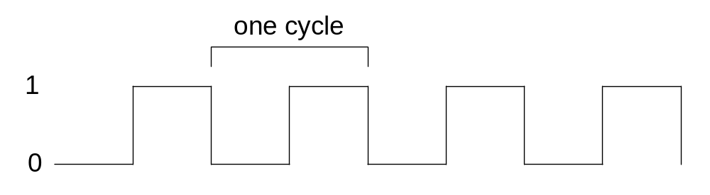
Clock
synchronizes all CPU and BUS operations
machine (clock) cycle measures time of a single operation
clock is used to trigger events
the duration of a clock cycle is calculated as the reciprocal of the clock’s speed
the speeds of the CPU, the system bus, and memory circuits are usually different
Irvine, Kip R. Assembly Language for Intel-Based Computers 5/e, 2007.

Slide 6
What's Next
General Concepts
IA-32 Processor Architecture
IA-32 Memory Management
Components of an IA-32 Microcomputer
Input-Output System
Irvine, Kip R. Assembly Language for Intel-Based Computers 5/e, 2007.

Slide 7
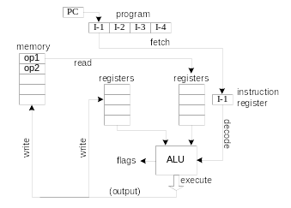
Instruction Execution Cycle
Fetch
Decode
Fetch operands
Execute
Store output
Why the instruction execution is divided into multiple stages?
Irvine, Kip R. Assembly Language for Intel-Based Computers 5/e, 2007.

Slide 8
Multi-Stage Pipeline
Pipelining makes it possible for processor to execute instructions in parallel
Instruction execution divided into discrete stages
Example of a non-pipelined processor. Many wasted cycles.
Irvine, Kip R. Assembly Language for Intel-Based Computers 5/e, 2007.

Slide 9
Pipelined Execution
More efficient use of cycles, greater throughput of instructions:
For k stages and n instructions, the number of required cycles is:
k + (n – 1)
Irvine, Kip R. Assembly Language for Intel-Based Computers 5/e, 2007.

Slide 10
Wasted Cycles (pipelined)
When one of the stages requires two or more clock cycles, clock cycles are again wasted.
For k stages and n instructions, the number of required cycles is:
k + (2n – 1)
Irvine, Kip R. Assembly Language for Intel-Based Computers 5/e, 2007.

Slide 11
Superscalar
A superscalar processor has multiple execution pipelines. In the following, note that Stage S4 has left and right pipelines (u and v).
For k stages and n instructions, the number of required cycles is:
k + n
Irvine, Kip R. Assembly Language for Intel-Based Computers 5/e, 2007.

Slide 12
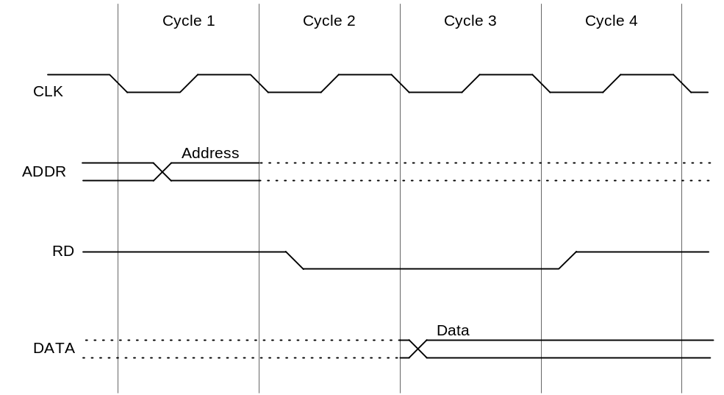
Reading from Memory
Multiple machine cycles are required when reading from memory, because it responds much more slowly than the CPU. The steps are:
  address placed on address bus
  Read Line (RD) set low
  CPU waits one cycle for memory to respond
  Read Line (RD) goes to 1, indicating that the data is on the data bus — much slower than the internal clock of CPU
Irvine, Kip R. Assembly Language for Intel-Based Computers 5/e, 2007.

Slide 13
Cache Memory
High-speed expensive static RAM (SRAM) inside CPU.
  Level-1 cache: smallest size, fastest
  Level-2 cache: medium size, medium speed
  Level-3 cache: largest size, slowest but still much smaller and faster than dynamic RAM (DRAM) used in memory
Cache hit: when data to be read is already in cache memory
Cache miss: when data to be read is not in cache memory.
Temporal and spatial locality
Irvine, Kip R. Assembly Language for Intel-Based Computers 5/e, 2007.

Slide 14
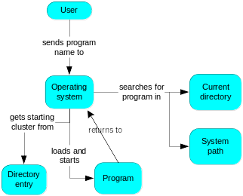
How a Program Runs
Irvine, Kip R. Assembly Language for Intel-Based Computers 5/e, 2007.

Slide 15
Multitasking
OS can run multiple programs at the same time.
Multiple threads of execution can run within the same program.
Scheduler utility assigns a given amount of CPU time to each running program.
Rapid switching of tasks
  gives illusion that all programs are running at once
  the processor must support task switching.
Irvine, Kip R. Assembly Language for Intel-Based Computers 5/e, 2007.

Slide 16
IA-32 Processor Architecture
Modes of operation
Basic execution environment
Floating-point unit
Intel Microprocessor history
Irvine, Kip R. Assembly Language for Intel-Based Computers 5/e, 2007.

Slide 17
Modes of Operation
Protected mode
  native mode (Windows, Linux)
  programs are given separate memory areas named segments
  processor prevents programs from referencing memory outside their assigned segments – segmentation fault
Real-address mode
  the programming environment of the Intel 8086 processor with the ability to switch into other modes (MS-DOS)
System management mode
  power management, system security, diagnostics
Virtual-8086 mode
  A sub-mode of Protected
  each program has its own 8086 computer
Irvine, Kip R. Assembly Language for Intel-Based Computers 5/e, 2007.

Slide 18
Basic Execution Environment
Addressable memory
General-purpose registers
Index and base registers
Specialized register uses
Status flags
Floating-point, MMX, XMM registers
Irvine, Kip R. Assembly Language for Intel-Based Computers 5/e, 2007.

Slide 19
Addressable Memory
Protected mode
  4 GB
  32-bit address
  Physical Addressing Extension (PAE) – 64GB
Real-address and Virtual-8086 modes
  1 MB space
  20-bit address
Irvine, Kip R. Assembly Language for Intel-Based Computers 5/e, 2007.

Slide 20

Basic Program Execution Registers
Named storage locations inside the CPU, optimized for speed.
Irvine, Kip R. Assembly Language for Intel-Based Computers 5/e, 2007.

Slide 21


Accessing Parts of Registers
Use 8-bit name, 16-bit name, or 32-bit name
Applies to EAX, EBX, ECX, and EDX
Irvine, Kip R. Assembly Language for Intel-Based Computers 5/e, 2007.

Slide 22

Index and Base Registers
Some registers have only a 16-bit name for their lower half:
Irvine, Kip R. Assembly Language for Intel-Based Computers 5/e, 2007.

Slide 23
Some Specialized Register Uses (1 of 2)
General-Purpose
  EAX – automatically used by multiplication and division, called Extended Accumulator Register
  ECX – loop counter
  ESP – stack pointer, called Extended Stack Pointer Register
  ESI, EDI – index registers, called Extended Source Index Register and Extended Destination Register
  EBP – function parameters and local variables on the stack, called Extended Frame Pointer
Irvine, Kip R. Assembly Language for Intel-Based Computers 5/e, 2007.

Slide 24
Some Specialized Register Uses (2 of 2)
  Segment
  CS – code segment
  DS – data segment
  SS – stack segment
  ES, FS, GS - additional segments
EIP – instruction pointer, contains the address of the next instruction to be executed
EFLAGS
  status and control flags
  each flag is a single binary bit
Irvine, Kip R. Assembly Language for Intel-Based Computers 5/e, 2007.

Slide 25
Status Flags
Carry (CF)
  unsigned arithmetic out of range
Overflow (OF)
  signed arithmetic out of range
Sign (SF)
  result is negative
Zero (ZF)
  result is zero
Auxiliary Carry (AC)
  carry from bit 3 to bit 4 in an 8-bit operand
Parity (PF)
  sum of 1 bits is an even number in the least-significant byte of the result
Irvine, Kip R. Assembly Language for Intel-Based Computers 5/e, 2007.

Slide 26

Floating-Point, MMX, XMM Registers
Eight 80-bit floating-point data registers
  ST(0), ST(1), . . . , ST(7)
  arranged in a stack
  used for all floating-point arithmetic
Eight 64-bit MMX registers and eight 128-bit XMM registers for single-instruction multiple-data (SIMD) operations
Irvine, Kip R. Assembly Language for Intel-Based Computers 5/e, 2007.

Slide 27
Intel Microprocessor History
Intel 8086, 80286
IA-32 processor family
P6 processor family
Intel64
CISC and RISC
Irvine, Kip R. Assembly Language for Intel-Based Computers 5/e, 2007.

Slide 28
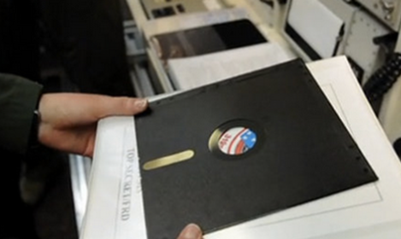
Early Intel Microprocessors
Intel 8080
  64K addressable RAM
  8-bit registers
  CP/M operating system
  S-100 BUS architecture
  8-inch floppy disks!
Intel 8086/8088
  IBM-PC Used 8088
  1 MB addressable RAM
  16-bit registers
  16-bit data bus (8-bit for 8088)
  separate floating-point unit (8087)
Irvine, Kip R. Assembly Language for Intel-Based Computers 5/e, 2007.

Slide 29
The IBM-AT
Intel 80286
  16 MB addressable RAM
  Protected memory
  several times faster than 8086
  introduced IDE bus architecture
  80287 floating point unit
Irvine, Kip R. Assembly Language for Intel-Based Computers 5/e, 2007.

Slide 30
Intel IA-32 Family
Intel386
  4 GB addressable RAM, 32-bit registers, paging (virtual memory)
Intel486
  instruction pipelining
  Integrated FPU
Pentium
  superscalar, 32-bit address bus, 64-bit internal data path
Irvine, Kip R. Assembly Language for Intel-Based Computers 5/e, 2007.

Slide 31
Intel P6 Family
Pentium Pro
  advanced optimization techniques in microcode
Pentium II
  MMX (multimedia) instruction set
Pentium III
  SIMD (streaming extensions) instructions
Pentium 4 and Xeon
  Intel NetBurst micro-architecture, tuned for multimedia
Irvine, Kip R. Assembly Language for Intel-Based Computers 5/e, 2007.

Slide 32
Intel64
Intel Celeron:
  dual-core, 512 KByte L2 cache, up to 2.2 GHz, 800 MHz bus
Intel Pentium
  dual-core, 2 MByte L2 cache, 1.6 to 2.7 GHz, 800 MHz bus
Core 2 Duo
  2 processor cores, 1.8–3.33 GHz, 64 bit, 6 MByte L2 cache
Core 2 Quad
  4 processor cores, up to 12 MByte L2 cache, 1333 MHz front side bus
Core i7
  4 processor cores, (up to 2.93 GHz), 8 processing threads, 8 MByte smart cache, 3 channels DDR3 memory
Irvine, Kip R. Assembly Language for Intel-Based Computers 5/e, 2007.

Slide 33
CISC and RISC
CISC – complex instruction set computer
  large instruction set
  high-level operations
  requires microcode interpreter
  examples: Intel 80x86 family
RISC – reduced instruction set computer
  simple, atomic instructions
  small instruction set
  directly executed by hardware
  examples:
    ARM (Advanced RISC Machines)
    RISC-V
Irvine, Kip R. Assembly Language for Intel-Based Computers 5/e, 2007.

Slide 34
What's Next
General Concepts
IA-32 Processor Architecture
IA-32 Memory Management
Components of an IA-32 Microcomputer
Input-Output System
Irvine, Kip R. Assembly Language for Intel-Based Computers 5/e, 2007.

Slide 35
IA-32 Memory Management
Real-address mode
Calculating linear addresses
Protected mode
Multi-segment model
Paging
Irvine, Kip R. Assembly Language for Intel-Based Computers 5/e, 2007.

Slide 36
Real-Address mode
1 MB RAM maximum addressable
Only 16-bit registers can be used
Application programs can access any area of memory
Single tasking
Supported by MS-DOS operating system
CS, DS, SS store segment addresses
Irvine, Kip R. Assembly Language for Intel-Based Computers 5/e, 2007.

Slide 37

Segmented Memory
Segmented memory addressing: absolute (linear) address is a combination of a 16-bit segment value added to a 16-bit offset
one segment
linear addresses
Irvine, Kip R. Assembly Language for Intel-Based Computers 5/e, 2007.

Slide 38
Calculating Linear Addresses
Given a segment address, multiply it by 16 (add a hexadecimal zero), and add it to the offset
Example: convert 08F1:0100 to a linear address
Adjusted Segment value: 0 8 F 1 0
Add the offset: 0 1 0 0
Linear address: 0 9 0 1 0
Irvine, Kip R. Assembly Language for Intel-Based Computers 5/e, 2007.

Slide 39
Your turn . . .
What linear address corresponds to the segment/offset address 028F:0030?
028F0 + 0030 = 02920
Always use hexadecimal notation for addresses.
Irvine, Kip R. Assembly Language for Intel-Based Computers 5/e, 2007.

Slide 40
Your turn . . .
What segment addresses correspond to the linear address 28F30h?
Many different segment-offset addresses can produce the linear address 28F30h. For example:
28F0:0030, 28F3:0000, 28B0:0430, . . .
Irvine, Kip R. Assembly Language for Intel-Based Computers 5/e, 2007.

Slide 41
Protected Mode (1 of 2)
4 GB addressable RAM
  (00000000 to FFFFFFFFh)
Each program assigned a memory partition which is protected from other programs
Designed for multitasking
Supported by Linux & MS-Windows
Irvine, Kip R. Assembly Language for Intel-Based Computers 5/e, 2007.

Slide 42
Protected mode (2 of 2)
Segment descriptor tables – used by operating systems to keep track of locations of individual program segments
Program structure
  code, data, and stack areas
  CS, DS, SS: reference segment descriptors in tables
MASM Programs use the Microsoft flat memory model
Irvine, Kip R. Assembly Language for Intel-Based Computers 5/e, 2007.

Slide 43
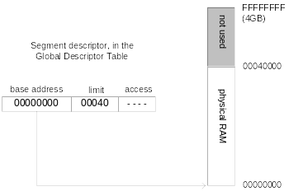
Flat Segment Model
Single global descriptor table (GDT).
All segments mapped to entire 32-bit address space
Irvine, Kip R. Assembly Language for Intel-Based Computers 5/e, 2007.

Slide 44
Multi-Segment Model
Each program has a local descriptor table (LDT)
  holds descriptor for each segment used by the program
Irvine, Kip R. Assembly Language for Intel-Based Computers 5/e, 2007.

Slide 45
Paging
Supported directly by the CPU
Divides each segment into 4096-byte blocks called pages
Sum of all programs can be larger than physical memory
Part of running program is in memory, part is on disk
Virtual memory manager (VMM) – OS utility that manages the loading and unloading of pages
Page fault – issued by CPU when a page must be loaded from disk
Irvine, Kip R. Assembly Language for Intel-Based Computers 5/e, 2007.

Slide 46
What's Next
General Concepts
IA-32 Processor Architecture
IA-32 Memory Management
Components of an IA-32 Microcomputer
Input-Output System
Irvine, Kip R. Assembly Language for Intel-Based Computers 5/e, 2007.

Slide 47
Components of an IA-32 Microcomputer
Motherboard
Video output
Memory
Input-output ports
Irvine, Kip R. Assembly Language for Intel-Based Computers 5/e, 2007.

Slide 48
Motherboard
CPU socket
Main memory slots
BIOS chips
Sound synthesizer chip (optional)
Video controller chip (optional)
IDE, parallel, serial, USB, video, keyboard, network, and mouse connectors
PCI bus connectors (expansion cards)
Irvine, Kip R. Assembly Language for Intel-Based Computers 5/e, 2007.

Slide 49
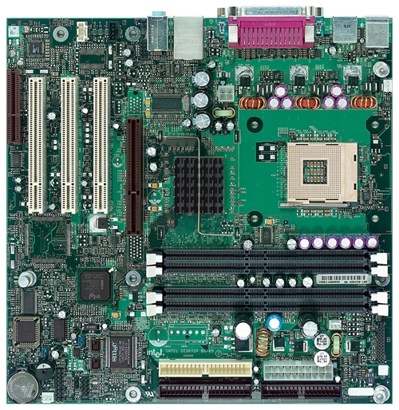
Intel D850MD Motherboard
mouse, keyboard, parallel, serial, and USB connectors
Video
Audio chip
PCI slots
memory controller hub
Pentium 4 socket
AGP slot
dynamic RAM
Firmware hub
I/O Controller
Speaker
Power connector
Battery
Diskette connector
Source: Intel® Desktop Board D850MD/D850MV Technical Product Specification
IDE drive connectors
Irvine, Kip R. Assembly Language for Intel-Based Computers 5/e, 2007.

Slide 50
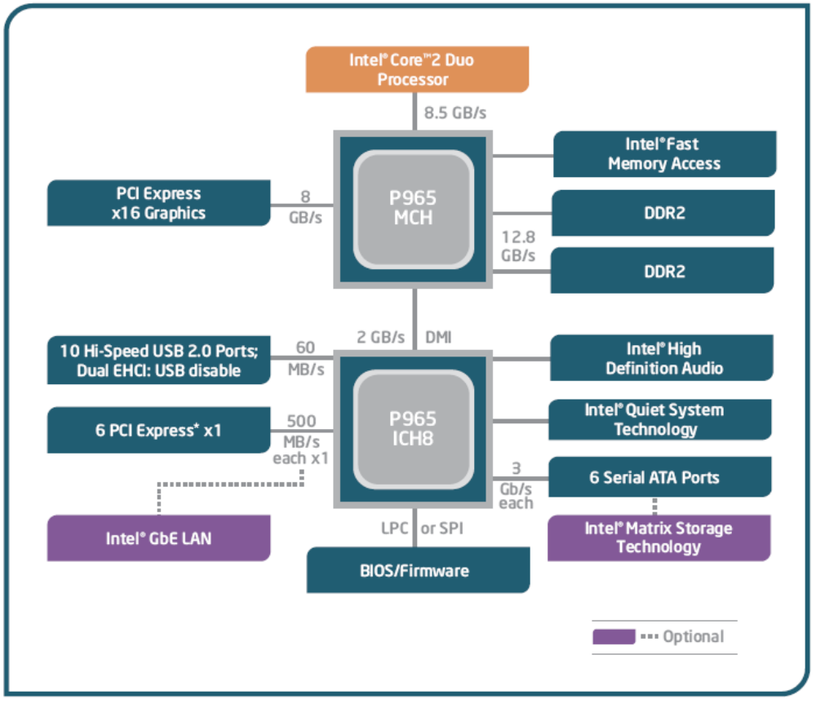
Motherboard Chipset
A motherboard chipset is a collection of processor chips designed to work together on a specific type of motherboard.
Intel 965:
Memory Controller Hub (MCH)
I/O Controller Hub (ICH8)
USB ports
PCI express slots
BIOS/Firmware
… …
Irvine, Kip R. Assembly Language for Intel-Based Computers 5/e, 2007.

Slide 51
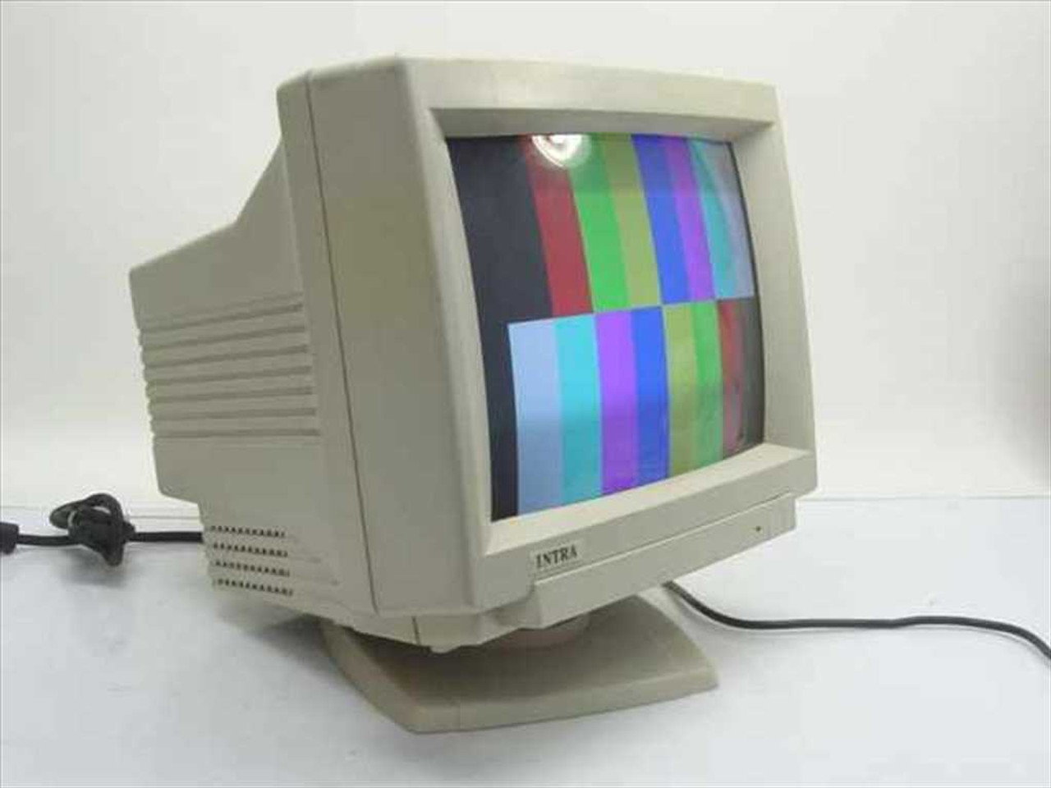
Video Output
Video controller
  on motherboard, or on expansion card
  AGP (accelerated graphics port technology)*
Video memory (VRAM)
Video CRT Display
  uses raster scanning
  horizontal retrace
  vertical retrace
Direct digital LCD monitors
  no raster scanning required
* This link may change over time.
Irvine, Kip R. Assembly Language for Intel-Based Computers 5/e, 2007.

Slide 52
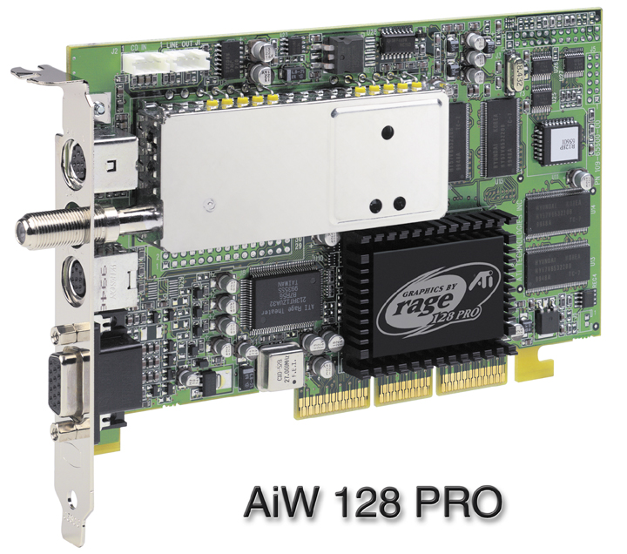
Sample Video Controller (ATI Corp.)
  128-bit 3D graphics performance powered by RAGE™ 128 PRO
  Intelligent TV-Tuner with Digital VCR
  TV-ON-DEMAND™
  Interactive Program Guide
  Still image and MPEG-2 motion video capture
  Video editing
  Hardware DVD video playback
  Video output to TV or VCR
Irvine, Kip R. Assembly Language for Intel-Based Computers 5/e, 2007.

Slide 53
Memory
ROM
  read-only memory
EPROM
  erasable programmable read-only memory
Dynamic RAM (DRAM)
  inexpensive; must be refreshed constantly
Static RAM (SRAM)
  expensive; used for cache memory; no refresh required
Video RAM (VRAM)
  dual ported; optimized for constant video refresh
CMOS RAM
  complimentary metal-oxide semiconductor
  system setup information
  powered by a small circular battery
See: Intel platform memory (Intel technology brief: link address may change)
Irvine, Kip R. Assembly Language for Intel-Based Computers 5/e, 2007.

Slide 54
Input-Output Ports
USB (universal serial bus)
  intelligent high-speed connection to devices
  USB hub connects multiple devices
  enumeration: computer queries devices
  supports hot connections
Parallel
  short cable, high speed
  common for printers
  bidirectional, parallel data transfer
Irvine, Kip R. Assembly Language for Intel-Based Computers 5/e, 2007.

Slide 55
Input-Output Ports (cont)
Serial
  RS-232 serial port
  one bit at a time
  support long cables
Irvine, Kip R. Assembly Language for Intel-Based Computers 5/e, 2007.

Slide 56
Device Interfaces
ATA host adapters
  intelligent drive electronics (hard drive, CDROM)
SATA (Serial ATA) host adapters
  inexpensive, fast, bidirectional
Bluetooth
  small amounts of data, short distances, low power usage
Wi-Fi (wireless Ethernet)
  IEEE 802.11 standard, faster than Bluetooth
Irvine, Kip R. Assembly Language for Intel-Based Computers 5/e, 2007.

Slide 57
What's Next
General Concepts
IA-32 Processor Architecture
IA-32 Memory Management
Components of an IA-32 Microcomputer
Input-Output System
Irvine, Kip R. Assembly Language for Intel-Based Computers 5/e, 2007.

Slide 58
Levels of Input-Output
Level 3: Call a library function (C++, Java)
  easy to do; abstracted from hardware; details hidden
  slowest performance
Level 2: Call an operating system function
  specific to one OS; device-independent
  medium performance
Level 1: Call a BIOS (basic input-output system) function
  may produce different results on different systems
  knowledge of hardware required
  usually good performance
Level 0: Communicate directly with the hardware
  May not be allowed by some operating systems
Irvine, Kip R. Assembly Language for Intel-Based Computers 5/e, 2007.

Slide 59
Displaying a String of Characters
When a High Level Language program displays a string of characters, the following steps take place:
Level 3 : call an operating system function and pass a string pointer
Level 2: use a loop to call a BIOS subroutine and pass the ASCII code and color of each character
Level 1: receive a character and map it to a particular system font and send the character to a hardware device
Level 0: display character
Irvine, Kip R. Assembly Language for Intel-Based Computers 5/e, 2007.

Slide 60
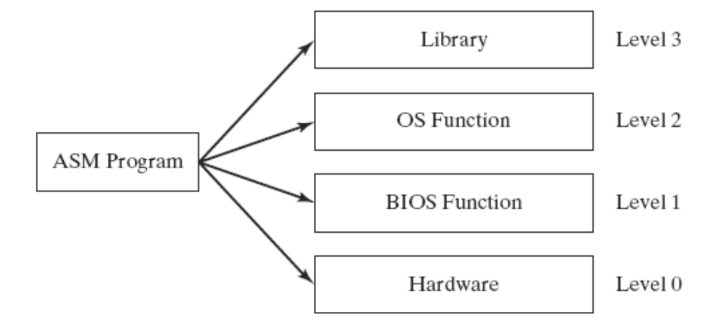
ASM Programming levels
ASM programs can perform input-output at each of the following levels:
Tradeoff between Control and Portability
Irvine, Kip R. Assembly Language for Intel-Based Computers 5/e, 2007.

Slide 61
Summary
Central Processing Unit (CPU)
Arithmetic Logic Unit (ALU)
Instruction execution cycle
Multitasking
Floating Point Unit (FPU)
Complex Instruction Set
Real mode and Protected mode
Motherboard components
Memory types
Input/Output and access levels
Irvine, Kip R. Assembly Language for Intel-Based Computers 5/e, 2007.

Slide 62

42 69 6E 61 72 79
What does this say?
Irvine, Kip R. Assembly Language for Intel-Based Computers 5/e, 2007.

